Slide 1
INDEX
1) INTORDUCTION TO KHILONA.COM
2) FOUNDER AND INVESTORS
3) SHORT DETAILS ABOUT US
4) WHO DO WE DO MARKETING ???
5) OUR MARKET IN BRIEF AND ALSO WHAT IS BANNU ??
6) SELLS TILL NOW
7) PROFIT CHART
8) PROOFS OF SELLS
9) TEAM DETAILS, CONTACT AND EMAIL ID
“4 lacs plus sells in just in 4 months.”

Slide 2
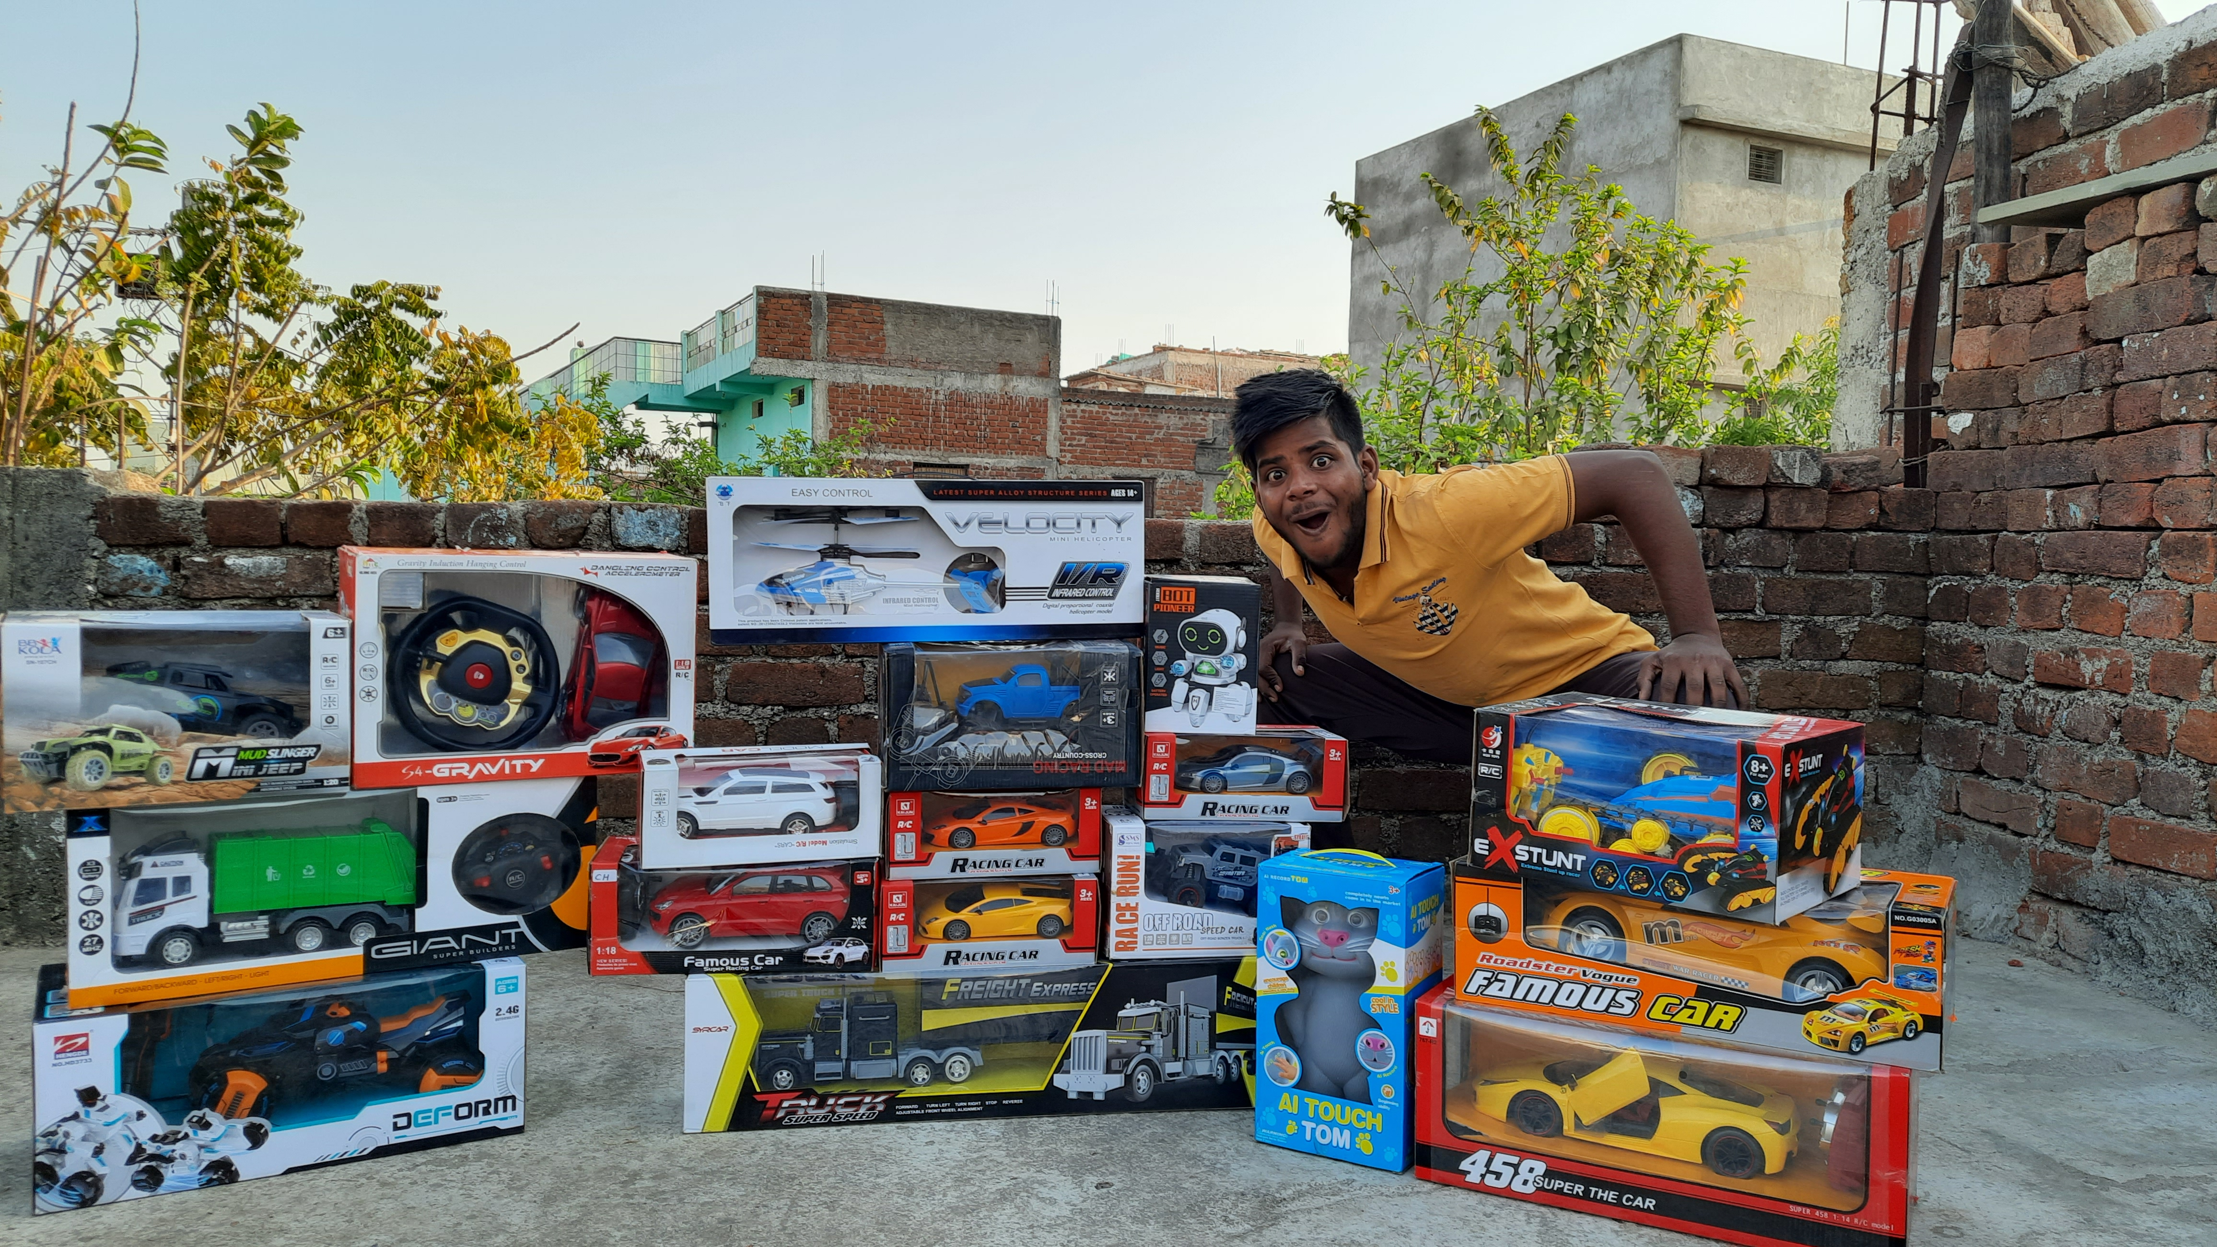
KHILONE(खिलौना)
GHAR SE DUKAN
विश्व गुरु भारत को आज खिलौनों के क्षेत्र में हमें बहुत ही ज्यादा आगे बढ़ाने की आवश्यकता है पूरी दुनिया का 91% खिलौना आज भारत में बाहर से खरीदा जाता है इसके लिए यह आवश्यक है कि हम इस ओर ध्यान दें|
बहुत बेच लिया,🔥🔥वादा है अब बनाएंगे
QUALITY AND BEST PRICE TOYS MARKET
Make In India

Slide 3
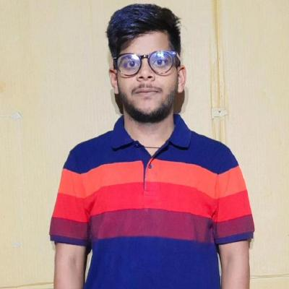
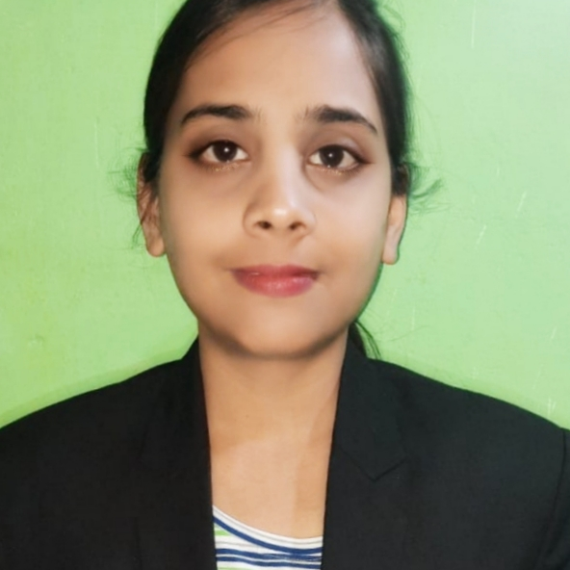
OUR TEAM
S
S
SANDEEP RAJAK
Shivanee Rajak
Founder of Bannu and Khilona.com
Investor in khilona.com
There are 7 people working with us and connected with 20 plus shops.

Slide 4
Short details about us
01
02
03
04
Problem
Bannu,RC
Marketing
BUSINESS
India’s Toys Market Is our, isn’t it???
Here you could describe the topic of the section
Using Adsence and Youtube responsership
Totally Toys Market with Reparable and transformable essensials

Slide 5
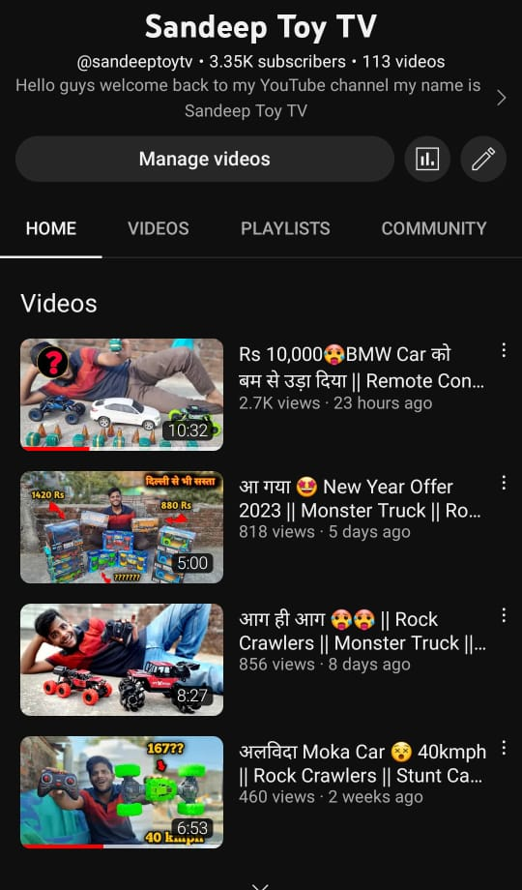
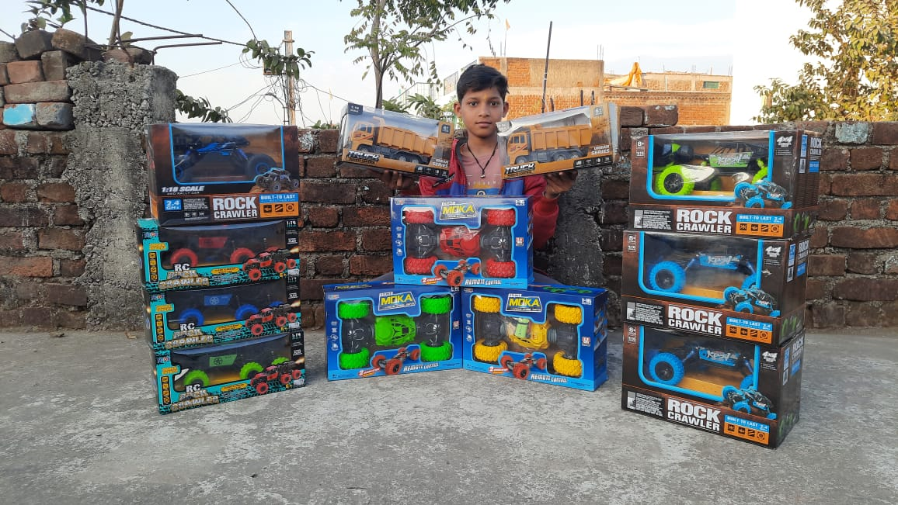
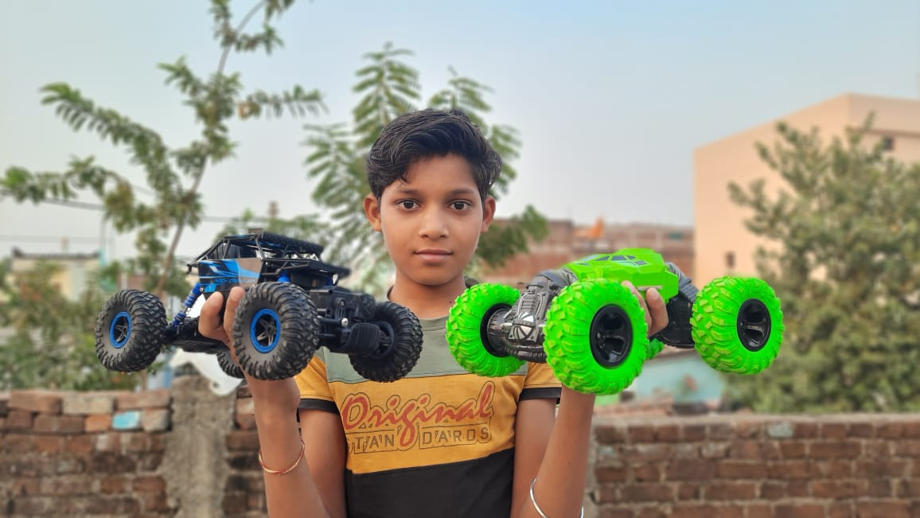
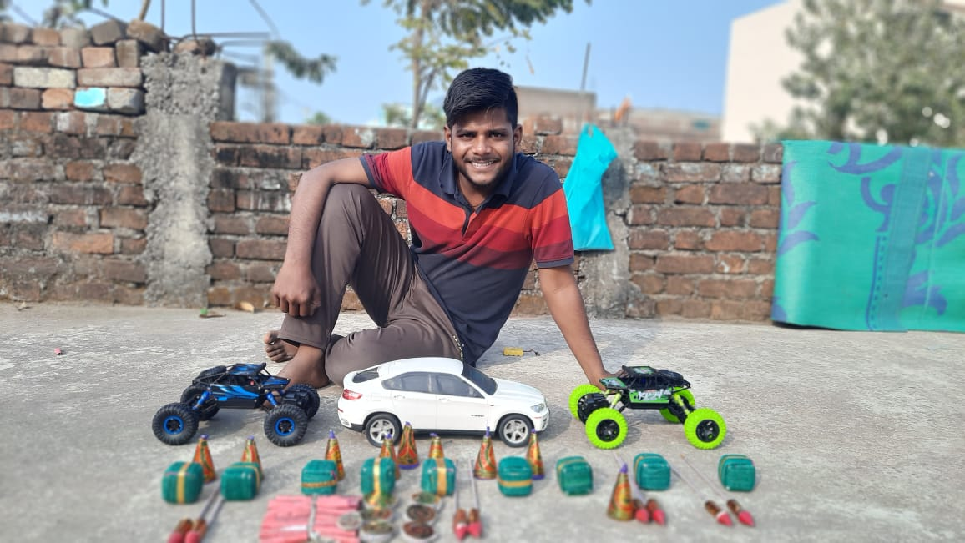
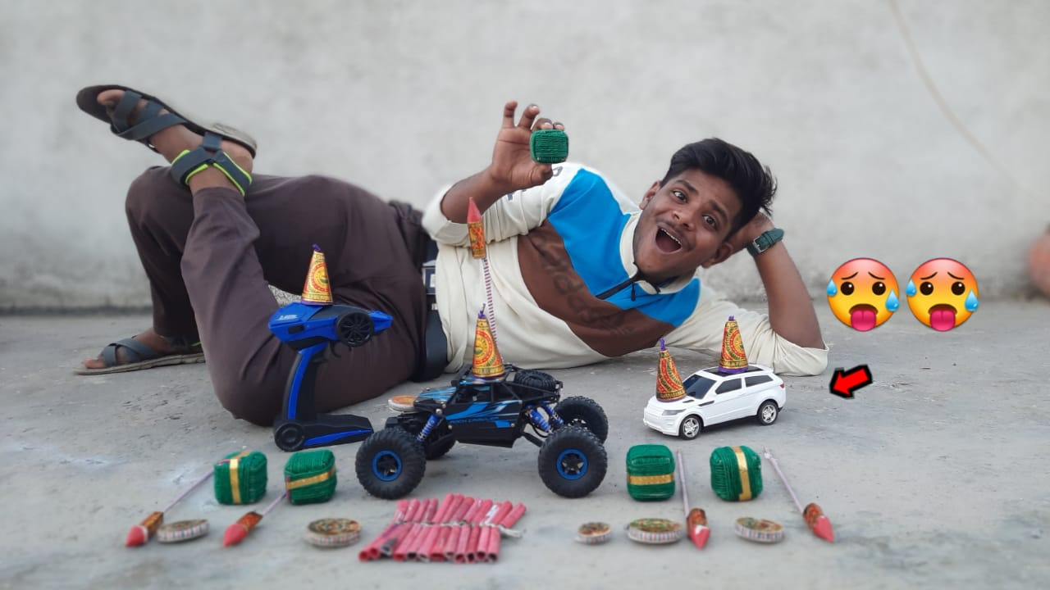
How do we do marketing:::::

Slide 6

OUR EXPERIENCE ABOUT TOYS and our Make In India Toys in Brief
WHAT IS BANNU???
1) We have been selling toys online since last one year through my youtube channel(“MP KA LADKA”, “Sandeep Toy Tv”), now we are growing day by day and we are making our website like reputated company Amazone and Flipkart.
2) Because we are pursuing my B.tech in Electronics and communication Branch so we have been very interested in electroic toys like RC toys, Rc Cars etc. and these toys are the dream of every child they want these toys any how but due to price high they can not afford it.
3) perticular product through better contacts and no third party integration is envolved that make us affordable. That’s By I have been able to do the selles of around 3.7 lacs last year.
4) In Toys industry if the toy verity is good then it is final it will give me 35% profit of its real cost. Means Best Profit Margin.
5) This market will never end and it is increasing day by day that’s i.e. very nice opportunity for us to make a part of it.
Bannu – It is our brand named as Bannu, when a heavy price toys doesn’t work then it is totally west of money we are the one who repair these toys with an amount of fees approx 500 rs depands on the toy price. We have got order from all over the india. We also provide lithium ION batteries to them.

Slide 7
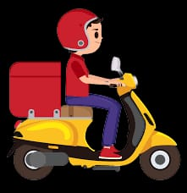
Sells Till Now
I have sold around 4.0+ lacs plus amount of toys using my youTube and Google ads.
Total sells = Rs. 4 lacs
Net profit excluding employees = Rs. 60K
“These toys I have been selling through youtube and using google adsence.”

Slide 8
PROFIT CHART
Employees Exp.
NET PROFIT
Here if online product base business so need of employees.
Net profit is really 35% in selling toys that’s nice in next slides I will show you proof.
25%
15%
20%
Its Cost Price
MARKETING
It takes total 40% of its orignal price. Import and Make In India Toy
40%
Marketing through google ads and other sporsership etc. also including packing and delivery

Slide 9
Proof of Our sells
Some links, AWS Id’s products which has been already delivered to my customers/.
https://www.ithinklogistics.co.in/postship/tracking/1323190773507
https://www.ithinklogistics.co.in/postship/tracking/I54625469
https://www.ithinklogistics.co.in/postship/tracking/1323118187194
https://www.ithinklogistics.co.in/postship/tracking/13625012669203
https://www.ithinklogistics.co.in/postship/tracking/1323118187194
These links are my few delivered orders

Slide 10
Team Details
Sandeep Rajak Electronics and communication Student
Shivanee Rajak IT Consultant Employee
5 other team members Studing Learners
Contact Number (Founder Sandeep Rajak) : 7024586411
Email Id (founder Sandeep Rajak) : rajaksandeep165@gmail.com
Channel link: https://www.youtube.com/channel/UCtDf4zOA0DWhhPuRxJg6twA

